Slide 1
ER DIAGRAM

Slide 2
ER model -- Database Modeling
The ER data model was developed to facilitate database design by allowing specification of an enterprise schema that represents the overall logical structure of a database.
The ER data model employs three basic concepts:
entity sets,
relationship sets,
attributes.
The ER model also has an associated diagrammatic representation, the ER diagram, which can express the overall logical structure of a database graphically.

Slide 3
Entity Sets
An entity is an object that exists and is distinguishable from other objects.
Example: specific person, company, event, plant
An entity set is a set of entities of the same type that share the same properties.
Example: set of all persons, companies, trees, holidays
An entity is represented by a set of attributes; i.e., descriptive properties possessed by all members of an entity set.
Example:
instructor = (ID, name, salary ) course= (course_id, title, credits)
A subset of the attributes form a primary key of the entity set; i.e., uniquely identifying each member of the set.

Slide 4
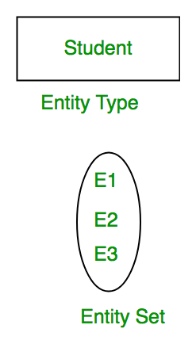
Entity Set - student

Slide 5
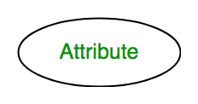
Attributes
Attributes are the properties which define the entity type.
In ER diagram, attribute is represented by an oval.
For example, Roll_No, Name, DOB, Age, Address, Mobile_No are the attributes which defines entity type Student.

Slide 6
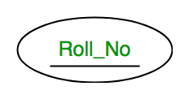
Key Attribute
The attribute which uniquely identifies each entity in the entity set is called key attribute.
For example, Roll_No will be unique for each student.
In ER diagram, key attribute is represented by an oval with underlying lines.

Slide 7
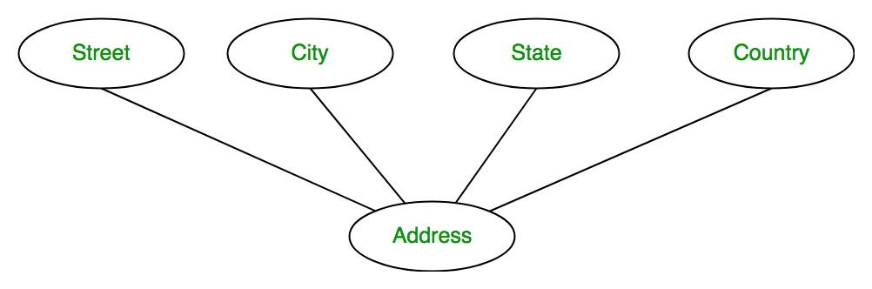
Composite Attribute
An attribute composed of many other attribute is called as composite attribute.
For example, Address attribute of student Entity type consists of Street, City, State, and Country.
In ER diagram, composite attribute is represented by an oval comprising of ovals.

Slide 8
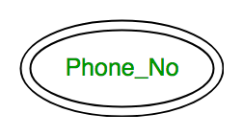
Multivalued Attribute
An attribute consisting more than one value for a given entity.
For example, Phone_No (can be more than one for a given student).
In ER diagram, multivalued attribute is represented by double oval.

Slide 9
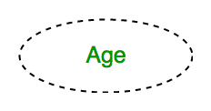
Derived Attribute
An attribute which can be derived from other attributes of the entity type is known as derived attribute.
e.g.; Age (can be derived from DOB).
In ER diagram, derived attribute is represented by dashed oval.

Slide 10
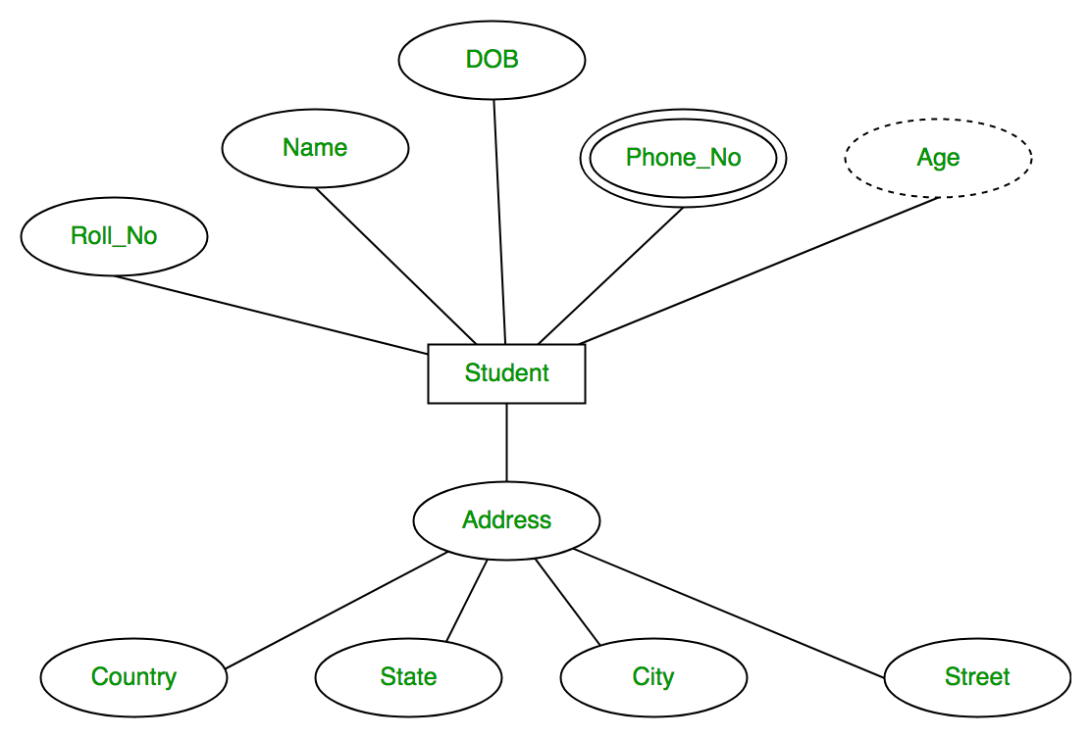
The complete entity type Student with its attributes can be represented as

Slide 11
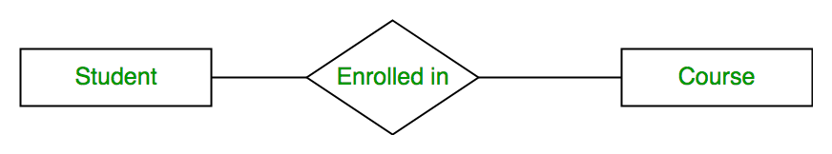
Relationship Type and Relationship Set
A relationship type represents the association between entity types.
For example,‘Enrolled in’ is a relationship type that exists between entity type Student and Course.
In ER diagram, relationship type is represented by a diamond and connecting the entities with lines.

Slide 12
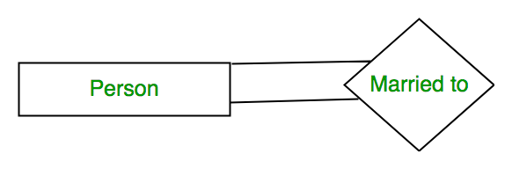
Degree of a relationship set
The number of different entity sets participating in a relationship set is called as degree of a relationship set.
Unary Relationship
When there is only ONE entity set participating in a relation, the relationship is called as unary relationship.
For example, one person is married to only one person.

Slide 13
Binary Relationship
When there are TWO entities set participating in a relation, the relationship is called as binary relationship.
For example, Student is enrolled in Course.

Slide 14
n-ary Relationship
When there are n entities set participating in a relation, the relationship is called as n-ary relationship.
Cardinality
The number of times an entity of an entity set participates in a relationship set is known as cardinality.

Slide 15
Constraints
Constraints are used for modeling limitations on the relations between entities.
There are two types of constraints on the Entity Relationship (ER) model
Mapping cardinality or cardinality ratio.
One-to-one
One-to-many
Many-to-one
Many-to-many
Participation constraints.
Total participation
Partial Participation

Slide 16
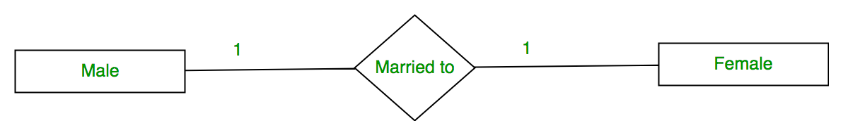
One to One
When each entity in each entity set can take part only once in the relationship, the cardinality is one to one.

Slide 17
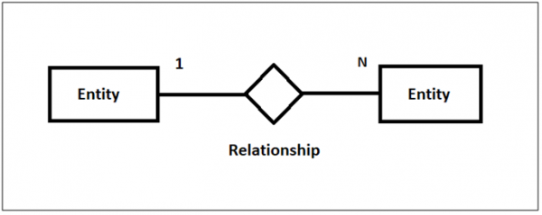
One to Many
When entities in one entity set can take part only once in the relationship set and entities in other entity set can take part more than once in the relationship set, cardinality is many to one.
Let us assume that one student can take multiple courses.
So the cardinality will be 1 to n.

Slide 18
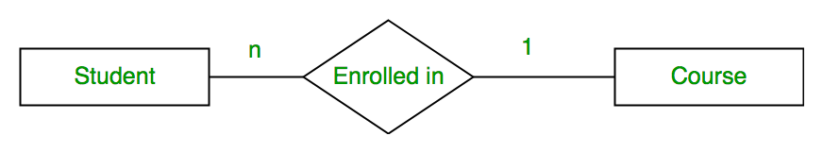
Many to One
When entities in one entity set can take part only once in the relationship set and entities in other entity set can take part more than once in the relationship set, cardinality is many to one.
Let us assume that a student can take only one course but one course can be taken by many students.
So the cardinality will be n to 1.
It means that for one course there can be n students but for one student, there will be only one course.

Slide 19
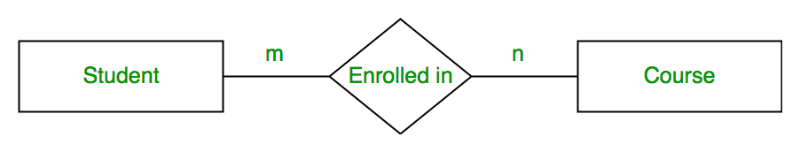
Many to Many
When entities in all entity sets can take part more than once in the relationship cardinality is many to many.
Let us assume that a student can take more than one course and one course can be taken by many students.
So the relationship will be many to many.

Slide 20
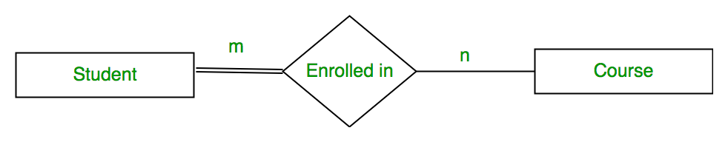
Total participation
Each entity in the entity set must participate in the relationship.
If each student must enroll in a course, the participation of student will be total.
Total participation is shown by double line in ER diagram.

Slide 21
Partial Participation
The entity in the entity set may or may NOT participate in the relationship.
If some courses are not enrolled by any of the student, the participation of course will be partial.
The diagram depicts the ‘Enrolled in’ relationship set with Student Entity set having total participation and Course Entity set having partial participation.

